Slide 1
Computer Networks
By
Lt Col Ishtiaq Kiani
(10 Sep 12 to 12 Jan 13)

Slide 2
Computer Networks - Grading
Assignments : 10
Quizzes : 10
2 x Hourly Exam : 30 (15 each)
Final Exam : 50
Total : 100

Slide 3
Computer Networks
Text Book: Data Communications and Networking, 4TH Edition
By Behrouz A Forouzan
Ref Books: 1. Computer Networks, 4TH Edition
By Andrew S. Tanenbaum
2. Communication Networks, 2ND Edition
By Alberto Leon Garcia
3. Computer Networking, 4TH Edition
By James F. Kurose

Slide 4
Course Contents
Part 1 : Introduction and Network Models
Part 2 : Physical Layer and Media
Part 3 : Data Link Layer
Part 4 : Network Layer
Part 5 : Transport layer
Part 6 : Application Layer
Part 7 : Security

Slide 5
PART 1

Slide 6
Chapter 1 Introduction
Data Communication
Networks
Protocols and Standards
Standard Organizations

Slide 7
Data Communication
Data Communication System depends upon four fundamental Characteristics
Delivery
Accuracy
Timeliness
Jitter

Slide 8
Components of Data Communication System
Five Major Components

Slide 9
Data Communication
Data can be represented as:-
Text
Numbers
Images
Audio
Video

Slide 10
Data Communication
Data Flow between two devices can be:-
Simplex

Slide 11
Data Communication
Half-Duplex

Slide 12
Data Communication
Full-Duplex

Slide 13
Computer Networks

Slide 14
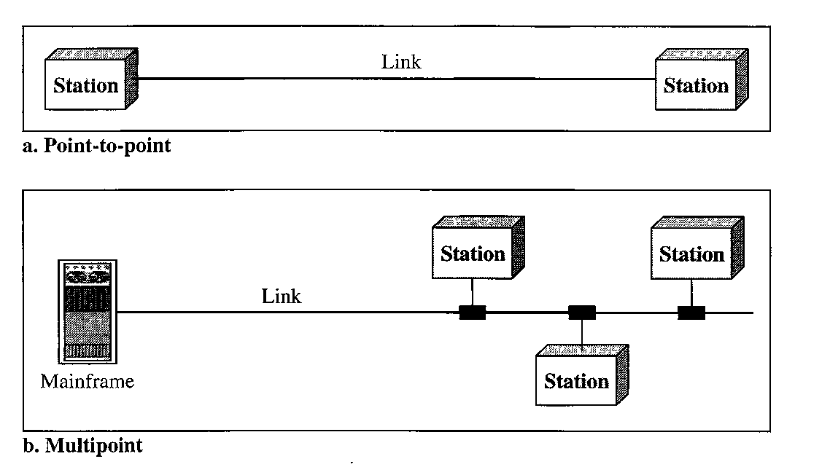
Computer Networks
Type of Connections:-
Point to Point
Multipoint

Slide 15
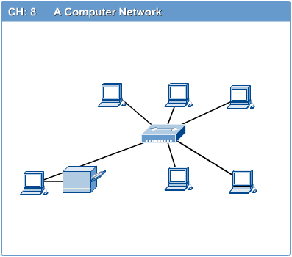
Cat of Networks
Computer Networks
Computer network connects two or more autonomous computers.
The computers can be geographically located anywhere.

Slide 16
Cat of Networks
Introduction to Computer Networks
Computer Networks
Network in small geographical Area (Room, Building or a Campus) is called LAN (Local Area Network)
The Local Network (LAN)
Client
Client
Client
Client
Client
Client

Slide 17
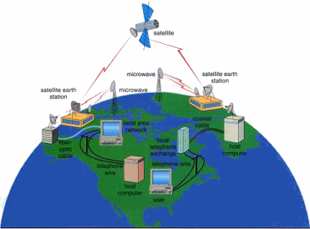
Cat of Networks
Introduction to Computer Networks
Computer Networks
Network in a City is call MAN (Metropolitan Area Network)

Slide 18
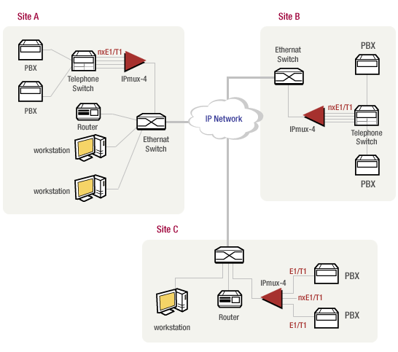
Cat of Networks
Introduction to Computer Networks
Computer Networks
Network spread geographically (Country or across Globe) is called WAN (Wide Area Network)

Slide 19
Computer Networks
Internet

Slide 20
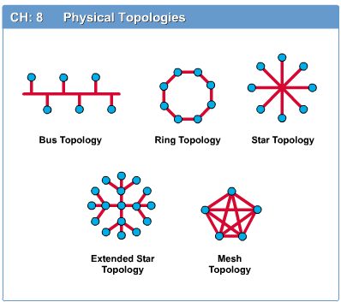
Network Topology
Introduction to Computer Networks
Computer Networks
The network topology defines the way in which computers, printers, and other devices are connected.
A network topology describes the layout of the wire and devices as well as the paths used by data transmissions.

Slide 21
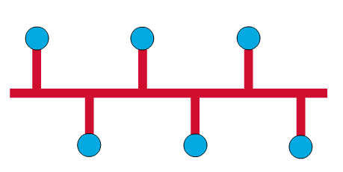
Computer Networks
Bus Topology
Commonly referred to as a linear bus, all the devices on a bus topology are connected by one single cable.

Slide 22
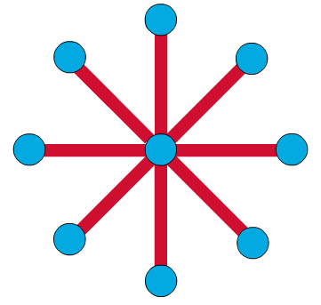
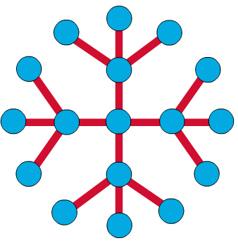
Introduction to Computer Networks
Computer Networks
Star & Tree Topology
The star topology is the most commonly used architecture in Ethernet LANs.
When installed, the star topology resembles spokes in a bicycle wheel.
Larger networks use the extended star topology also called tree topology. When used with network devices that filter frames or packets, like bridges, switches, and routers, this topology significantly reduces the traffic on the wires by sending packets only to the wires of the destination host.

Slide 23
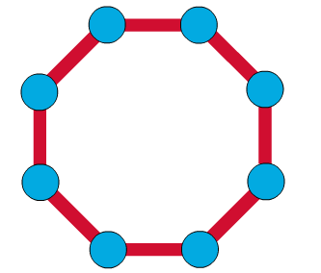
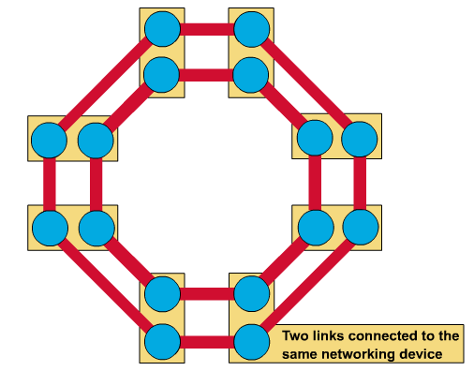
Ring Topology
Introduction to Computer Networks
Computer Networks
A frame travels around the ring, stopping at each node. If a node wants to transmit data, it adds the data as well as the destination address to the frame.
The frame then continues around the ring until it finds the destination node, which takes the data out of the frame.
Single ring – All the devices on the network share a single cable
Dual ring – The dual ring topology allows data to be sent in both directions.

Slide 24
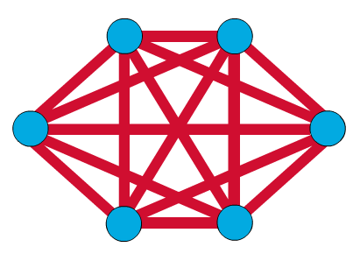
Mesh Topology
Computer Networks
The mesh topology connects all devices (nodes) to each other for redundancy and fault tolerance.
It is used in WANs to interconnect LANs and for mission critical networks like those used by banks and financial institutions.
Implementing the mesh topology is expensive and difficult.

Slide 25
Computer Networks
Hybrid Topology

Slide 26
Network Components
Introduction to Computer Networks
Computer Networks
Physical Media
Interconnecting Devices
Computers
Networking Software
Applications

Slide 27
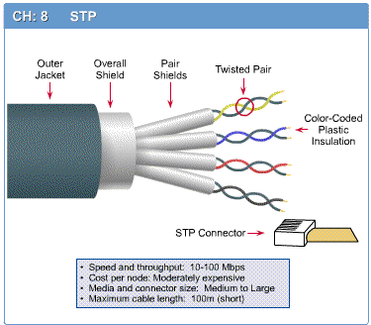
Networking Media
Introduction to Computer Networks
Computer Networks
Networking media can be defined simply as the means by which signals (data) are sent from one computer to another (either by cable or wireless means).

Slide 28
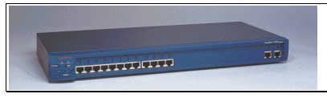
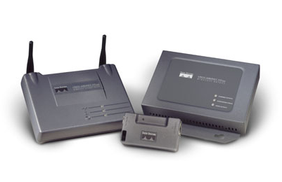
Networking Devices
Introduction to Computer Networks
Computer Networks
HUB, Switches, Routers, Wireless Access Points, Modems etc.

Slide 29

Applications
E-mail
Searchable Data (Web Sites)
E-Commerce
News Groups
Internet Telephony (VoIP)
Video Conferencing
Chat Groups
Instant Messengers
Internet Radio

Slide 30
Protocol
Introduction to Computer Networks
Protocols and Standards
Protocol is a set of rules that govern data communication
A protocol defines:-
What is communicated
How it is communicated
When it is communicated

Slide 31
Key Features of a Protocol
Protocols and Standards
Key Element of Protocol
Syntax
Concerns the format of the data blocks
Semantics
Includes control information for coordination and error handling
Timing
Includes speed matching and sequencing

Slide 32
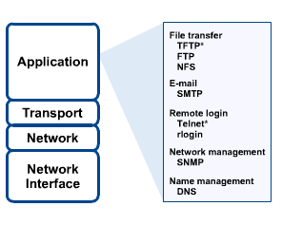
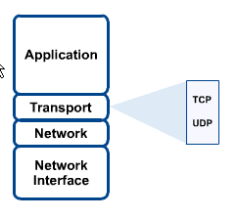
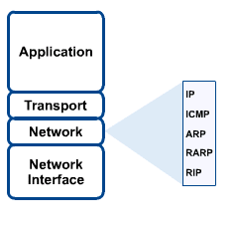
Networking Protocol: TCP/IP
Introduction to Computer Networks
Protocols and Standards

Slide 33
Protocols and Standards
Standards

Slide 34
Protocols and Standards
Standards Organizations
Standards are developed through the cooperation of standards creation committees, forums and government regulatory agencies.
Standards Creation Committees
International Organization for standardization (ISO)
International Telecommunication Union – Telecommunication standards Sector (ITU-T)
American National Standards Institute (ANSI)
Institute of Electrical and Electronics Engineers (IEEE)
Electronic Industries Association (EIA)

Slide 35
Chapter 2 OSI Model
The model
Functions of the layers

Slide 36
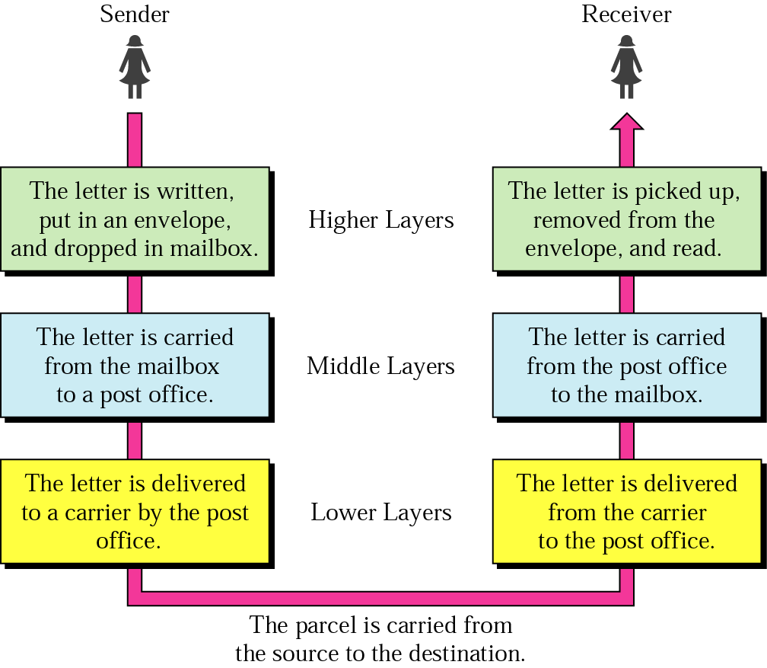
Sending a Letter

Slide 37
Layer Architecture
OSI Model
OSI Model
Layer architecture simplifies the network design.
It is easy to debug network applications in a layered architecture network.
The network management is easier due to the layered architecture.
Network layers follow a set of rules, called protocol.
The protocol defines the format of the data being exchanged, and the control and timing for the handshake between layers.

Slide 38
Open Systems Interconnection (OSI) Model
OSI Model
OSI Model
International standard organization (ISO) established a committee in 1977 to develop an architecture for computer communication.
Open Systems Interconnection (OSI) reference model is the result of this effort.
In 1984, the Open Systems Interconnection (OSI) reference model was approved as an international standard for communications architecture.
Term “open” denotes the ability to connect any two systems which conform to the reference model and associated standards.

Slide 39
OSI Reference Model
OSI Model
OSI Model
The OSI model is now considered the primary Architectural model for inter-computer communications.
The OSI model describes how information or data makes its way from application programmes (such as spreadsheets) through a network medium (such as wire) to another application programme located on another network.
The OSI reference model divides the problem of moving information between computers over a network medium into SEVEN smaller and more manageable problems .
This separation into smaller more manageable functions is known as layering.

Slide 40
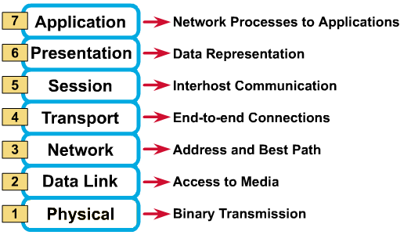
OSI Reference Model: 7 Layers
OSI Model
OSI Model

Slide 41
OSI: A Layered Network Model
OSI Model
The process of breaking up the functions or tasks of networking into layers reduces complexity.
Each layer provides a service to the layer above it in the protocol specification.
Each layer communicates with the same layer’s software or hardware on other computers.
The lower 4 layers (transport, network, data link and physical —Layers 4, 3, 2, and 1) are concerned with the flow of data from end to end through the network.
The upper four layers of the OSI model (application, presentation and session—Layers 7, 6 and 5) are orientated more toward services to the applications.
Data is Encapsulated with the necessary protocol information as it moves down the layers before network transit.

Slide 42
OSI Model

Slide 43
An Exchange Using the OSI Model

Slide 44
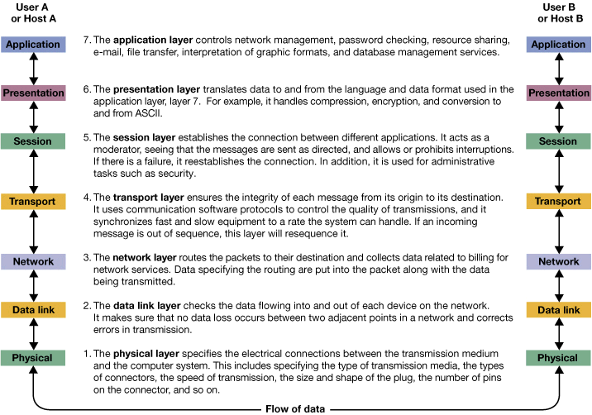
OSI Model
Flow of Data

Slide 45
OSI Model
Physical Layer

Slide 46
Functions of Physical Layer
OSI Model
Physical Characteristics of interfaces and medium
Representation of Bits
Data Rate
Synchronization of Bits
Line Configuration
Physical Topology
Transmission Mode

Slide 47
OSI Model
Data Link Layer

Slide 48
OSI Model
Data Link Layer Example

Slide 49
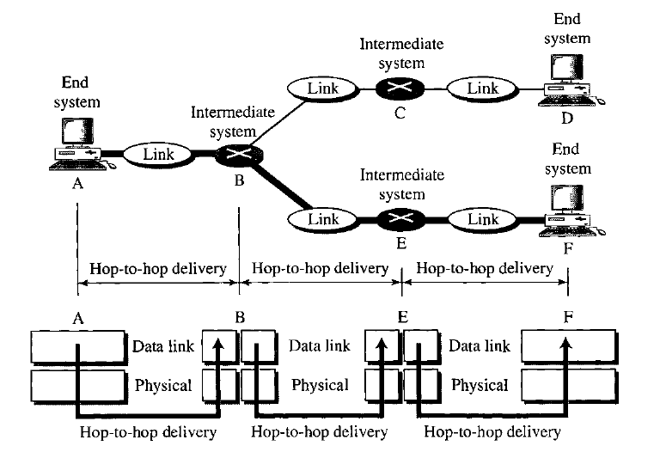
OSI Model
Data Link Layer Example
The data link layer is responsible for moving frames from hop to hop

Slide 50
Functions of Data Link Layer
OSI Model
Framing
Physical Addressing
Flow Control
Error Control
Access Control

Slide 51
OSI Model
Network Layer

Slide 52
OSI Model
Network Layer Example

Slide 53
OSI Model
Network Layer Example

Slide 54
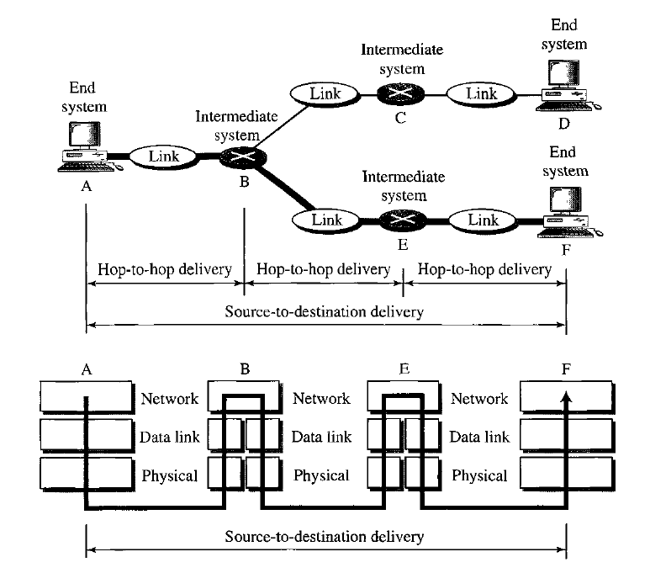

OSI Model
Network Layer Example

Slide 55
Functions of Network Layer
OSI Model
Logical Addressing
Routing

Slide 56
OSI Model
Transport Layer

Slide 57
OSI Model
Transport Layer Example

Slide 58
OSI Model
Transport Layer Example

Slide 59
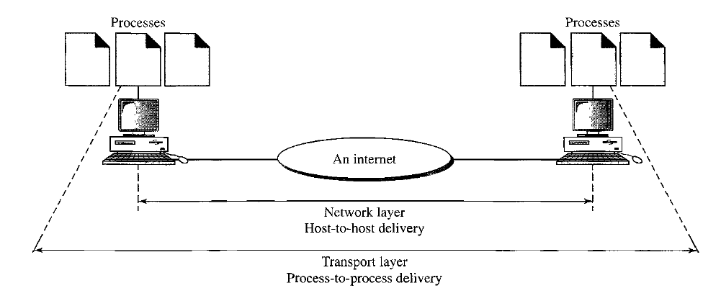
OSI Model
Transport Layer Example

Slide 60
Functions of Transport Layer
OSI Model
Service Point Addressing
Segmentation and reassembly
Connection Control
Flow Control
Error Control

Slide 61
OSI Model
Session Layer

Slide 62
Functions of Session Layer
OSI Model
Dialog Control
Synchronization

Slide 63
OSI Model
Presentation Layer

Slide 64
Functions of Presentation Layer
OSI Model
Translation
Encryption
Compression

Slide 65
OSI Model
Application Layer

Slide 66
Functions of Application Layer
OSI Model
Network Virtual Terminal
File transfer, access and management
Mail Services
Directory Services

Slide 67
OSI Model
Summary of Layer Functions

Slide 68
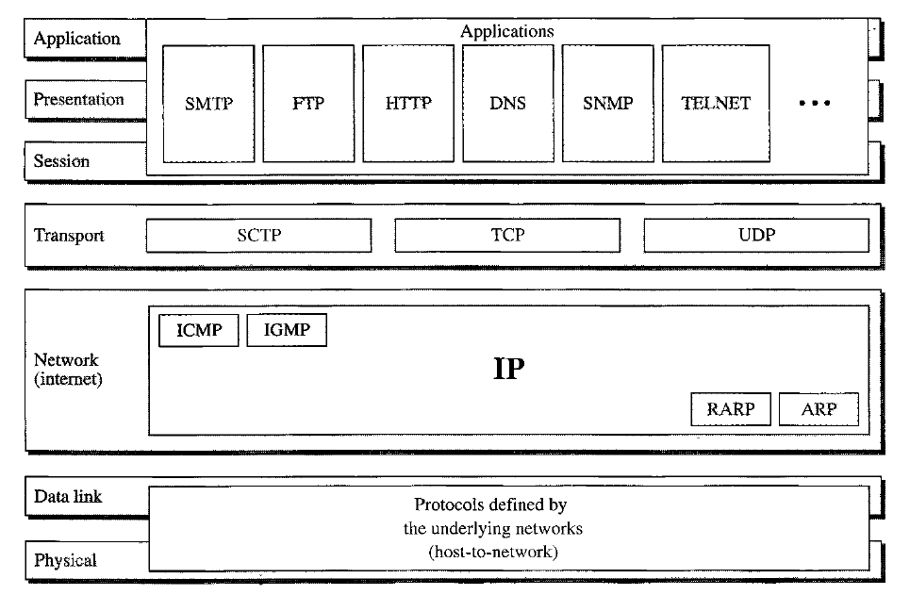
TCP/ IP Protocol Suite

Slide 69
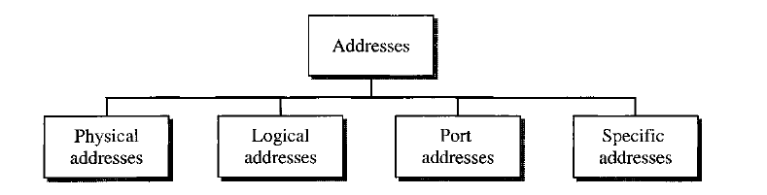
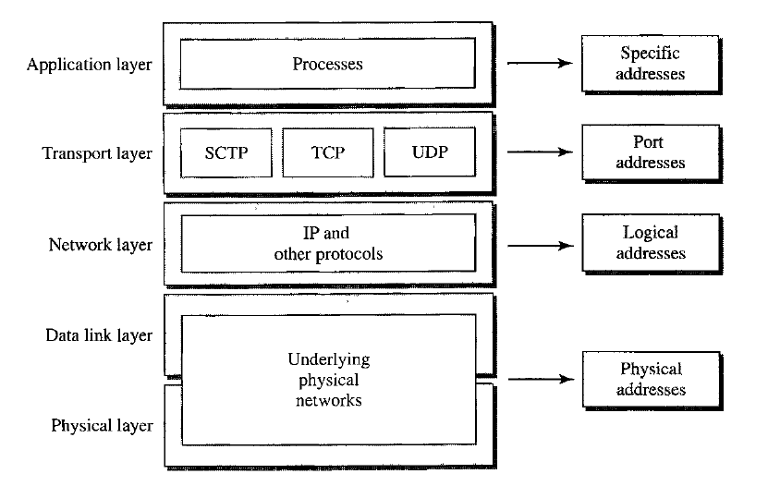
Addressing

